Slide 1
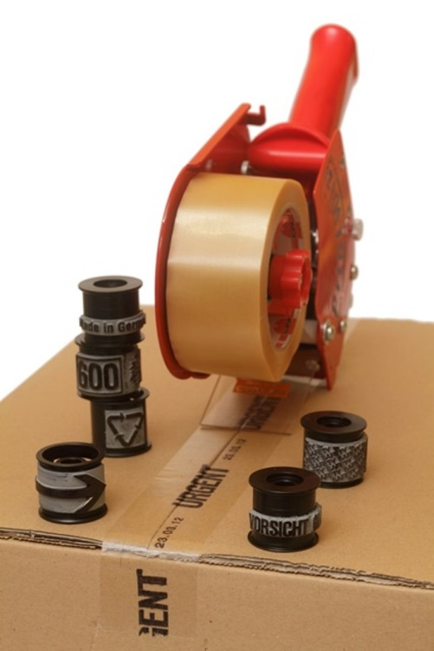
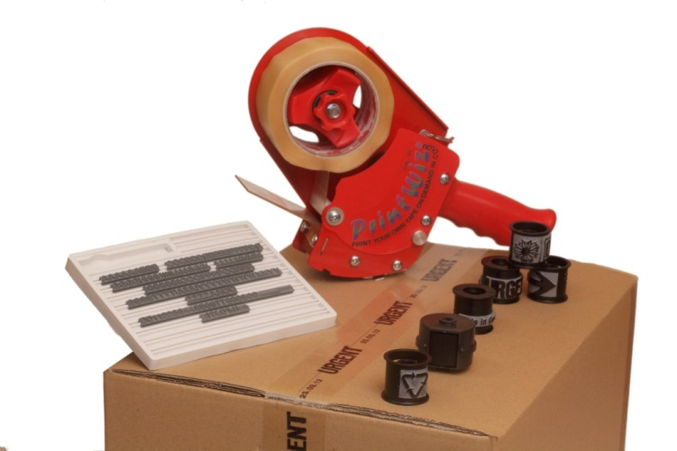
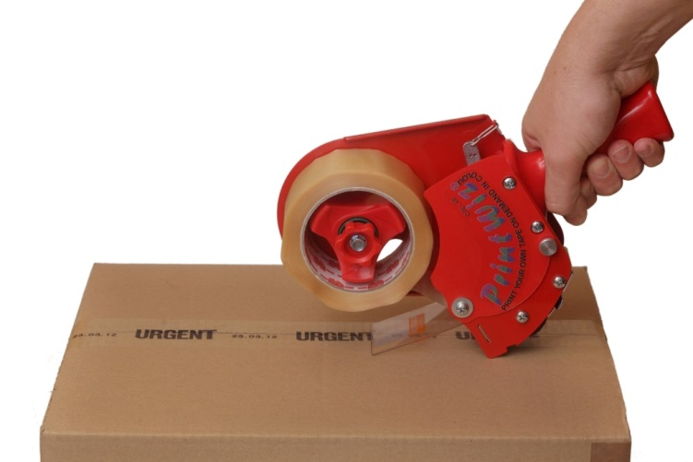
Introducing our PrintWiz STS
The most versatile mobile hand held tape printer / sealer on the market.
PrintWiz can be used as promotional tape printer but most important feature is the SECURITY aspect of the system.
The ability to print on the adhesive side of the tape, creates instant impression on the substrate, when tape is removed, traces will remain and evidence will be noticed immediately.
Replication of tape is impossible with out the original applicator.

Slide 2
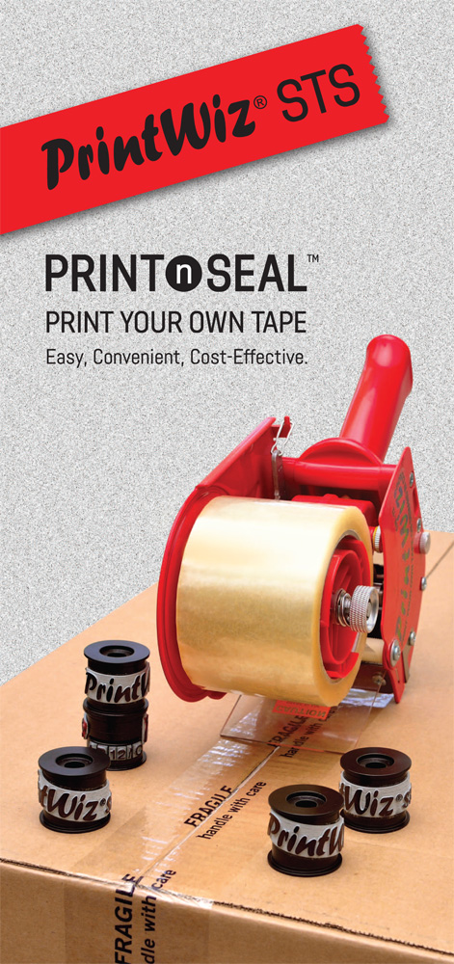
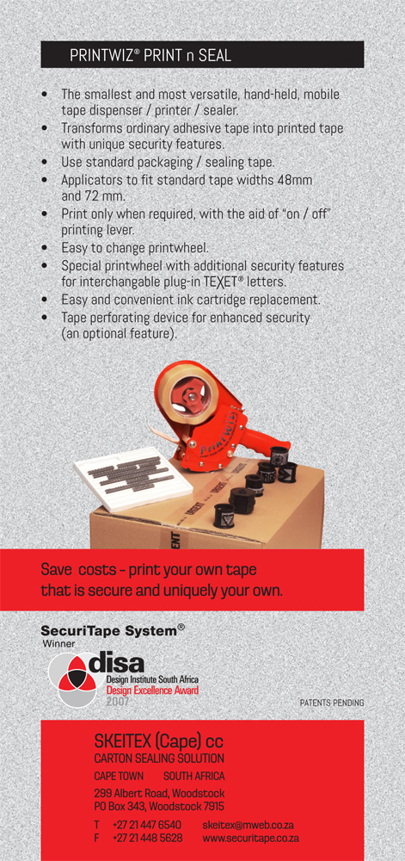
PrintWiz STS available for two size tapes
PW2 / 48mm PW3 / 72mm

Slide 3
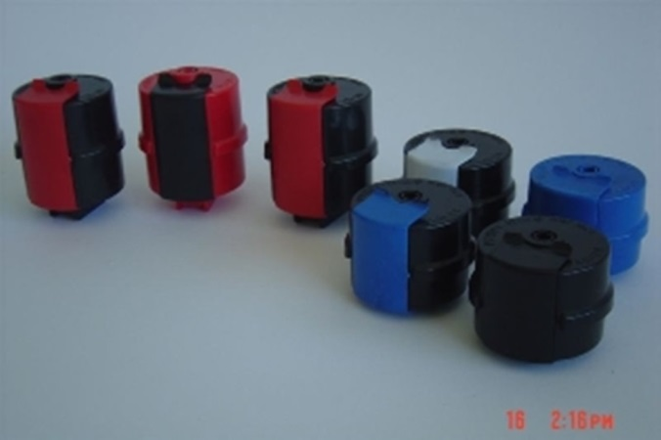
Ink Cartridges
Long lasting ink formula will ensure the use over long period of time.
Ink cartridge will last for 4 to 7000m of tape depending on print design.
At present the ink supplied in BLACK for the two models applicators.
Primary colours will be available in the future.
INK-#2 – 50-24 for 48mm – 2” applicator
INK-#3 – 75-36 for 72mm – 3” applicator
No leaks, no mass, no fuss.
Extremely convenient and easy to handle the replacement cartridge,

Slide 4
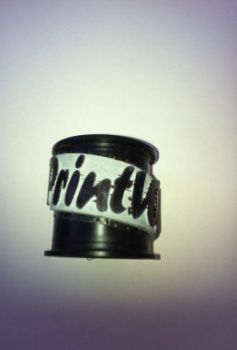
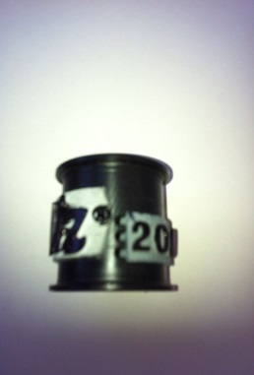

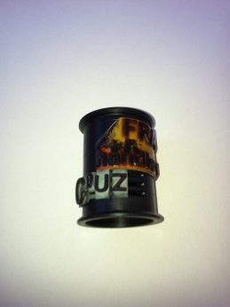
Printwheels
Parameters of rubber plate;
PWL-STD -#2 L< 80mm W<23mm
PWL-RIB -#2 L< 60mm W<23mm (to accept teXet STS)
PWL-STD -#3 L< 80mm W<35mm
PWL-RIB -#3 L< 60mm W<23mm (to accept teXet STS)
Easy change of information by exchanging the printwheels, one applicator can severe multiple tape prints.

Slide 5
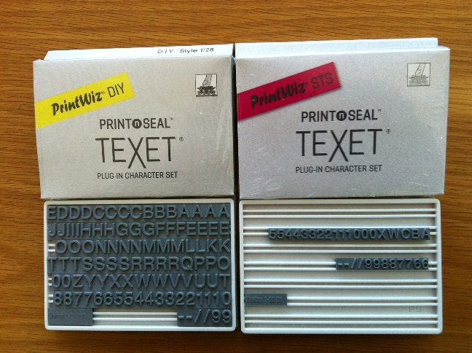
teXet plug-in character set
teXet STS (red) - set of 31 characters
teXet DIY (yellow) - set of 100 characters

Slide 6
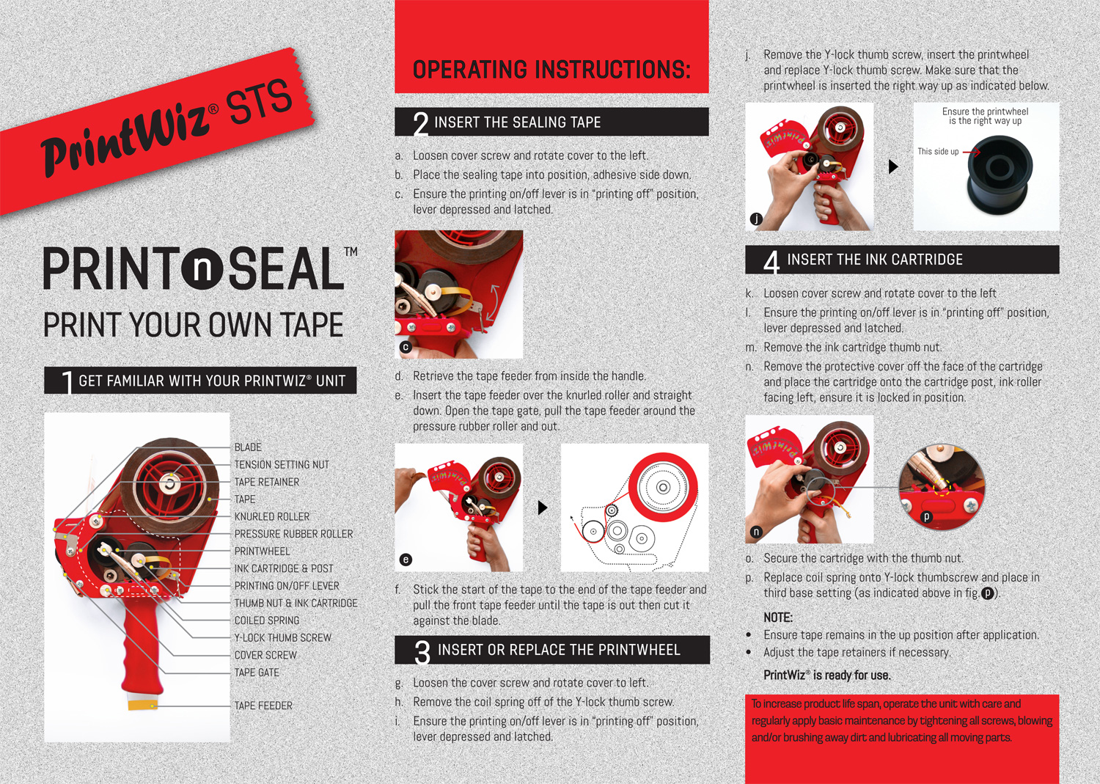
Operating Instruction

Slide 7
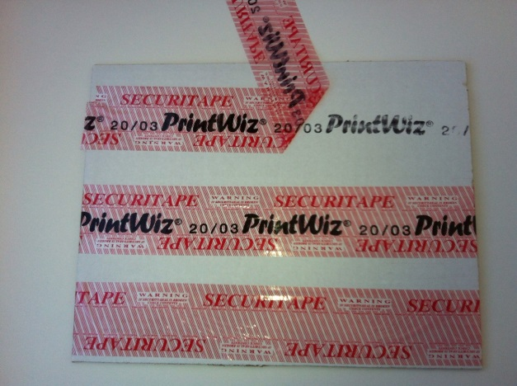
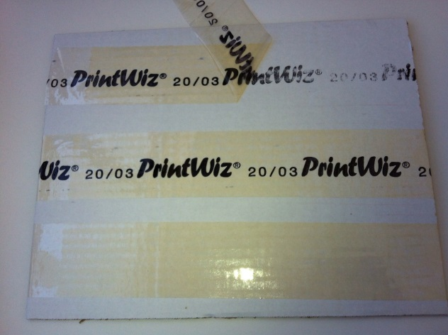
Tape for sealing with security
Our SECURITAPE warning tape easily transformed to a temper evident security tape when applied via our PrintWiz STS.
SECURITAPE warning tape
via PrintWiz
CLEAR (or any other plain coloured)
tape via PrintWiz

